Slide 1
Intelligent Curtain Wall System Architecture, Operation and Maintenance, and Dataset Management Platform
Members: Jishen Lin, Shuyi Liu, Amane Nakatani
Instructor: Jie Huang
School of Computer Science and Technology, Tongji University
2025 / 4 / 21

Slide 2
1
Project Planning
Contents
2
Project Execution and Monitoring
Risk Management &
Future improvements
3

Slide 3

01
Project Planning

Slide 4
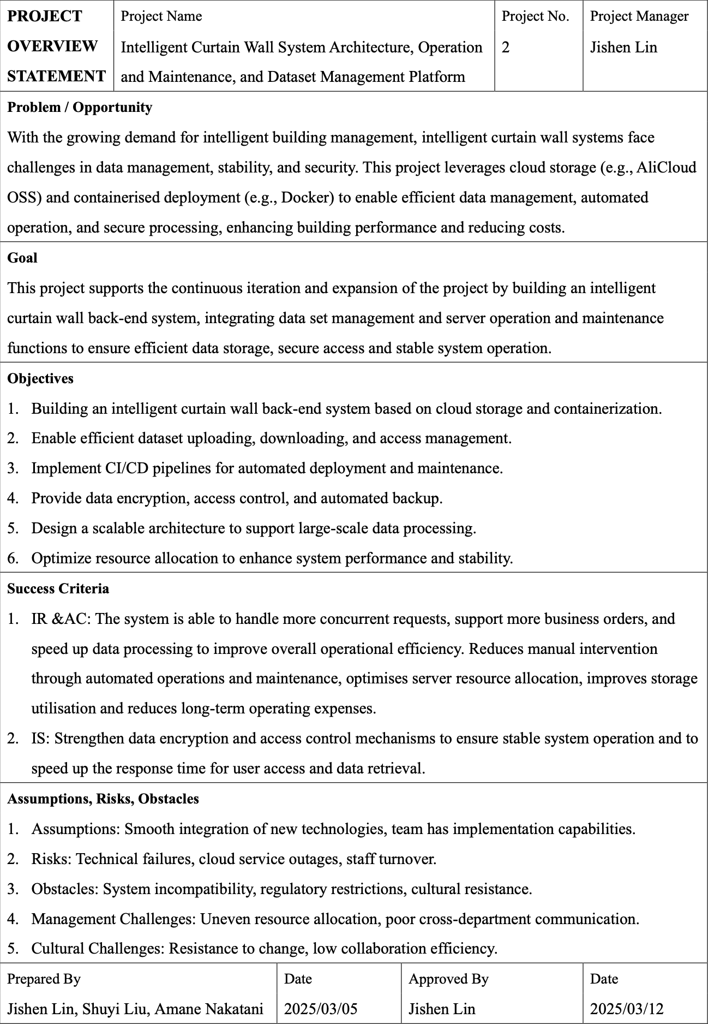
Project Planning
Building a smart curtain wall back-end system based on cloud storage and containerization.
Enable efficient dataset uploading, downloading, and access management.
Implement CI/CD pipelines for automated deployment and maintenance.
Provide data encryption, access control, and automated backup.
Design a scalable architecture to support large-scale data processing.
Optimize resource allocation to enhance system performance and stability.

Slide 5
02
Project Execution and Monitoring

Slide 6
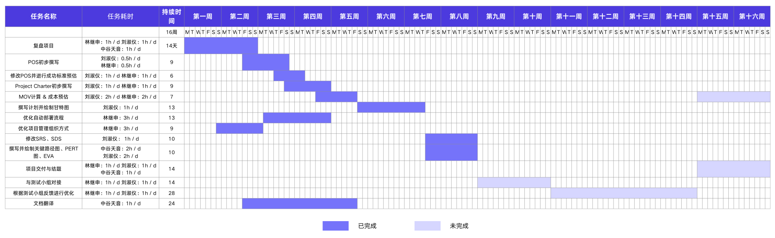
Project Execution and Monitoring
Figure 1: Project Gantt Chart

Slide 7
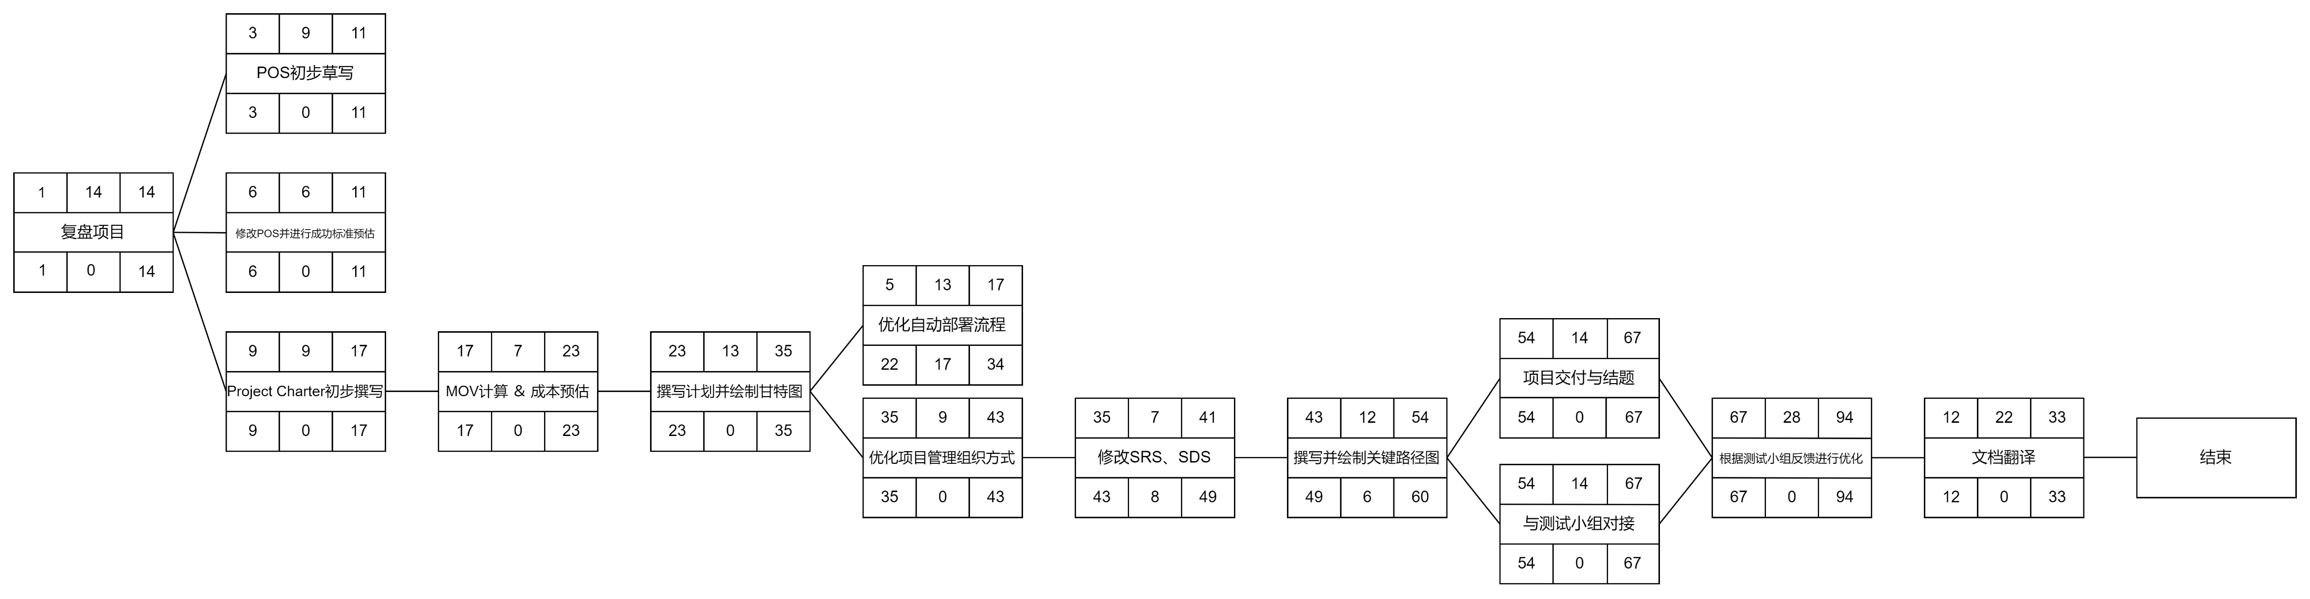
Project Execution and Monitoring
Figure 2: Project Critical Path Map

Slide 8
03
Risk Management &
Future Improvements

Slide 9
Risk Management & Future Improvements
3.1 Risk Management
During performance and stress testing, the production environment configuration may be insufficient. If necessary, consider upgrading server specifications.
System integration, deployment, and delivery may face resource shortages due to parallel tasks, requiring proper scheduling.
3.2 Future Improvements
Coordinate with the testing team to fix system-related bugs.
Conduct performance testing on the backend system to ensure high performance, high availability, and high load capacity.
Collaborate with all subsystem teams to complete the integrated deployment and delivery of the project.
Revise the SRS (Software Requirements Specification) and SDS (System Design Specification) documents.

Slide 10
Intelligent Curtain Wall System Architecture, Operation and Maintenance, and Dataset Management Platform
Thanks!
Members: Jishen Lin, Shuyi Liu, Amane Nakatani
Instructor: Jie Huang
School of Computer Science and Technology, Tongji University
2025 / 4 / 21

